Slide 1
Rahul Suppi ANANT

Slide 2

False Loan Word Detection
This presentation explores our project on detecting and classifying false loan words using fine-tuned transformer models, translation analysis, and similarity-based filtering. We've developed a robust pipeline leveraging multilingual BERT (mBERT) and Large Language Models to identify misinterpreted or falsely borrowed words across languages.
Our approach combines machine learning techniques with linguistic analysis to achieve accurate detection of words that appear to be borrowed but are not genuine loan words.

Slide 3





Project Overview & Objectives
Train Model for Loan Word Classification
Differentiate between genuine loan words and native words across languages
Detect False Loan Words
Identify words that appear to be borrowed but are not genuine loan words
Evaluate Semantic Drift
Use translation-based metrics (BLEU, METEOR) to measure meaning changes
Analyze Cross-Language Similarity
Use embedding similarity across languages to detect mismatches

Slide 4
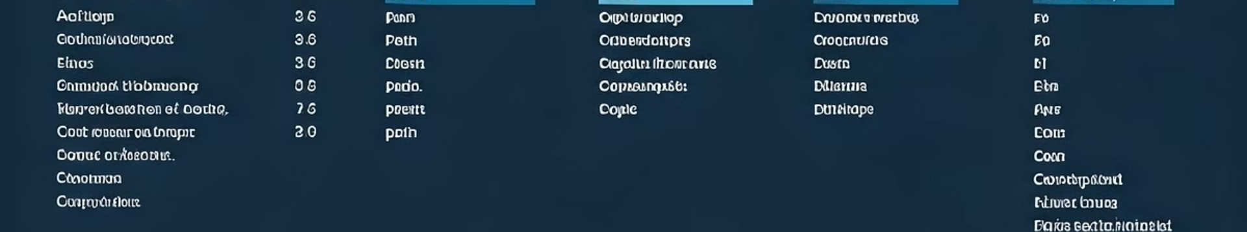
Dataset Structure
Loan Words
False Loan Words
Synonyms
Genuine borrowed words that maintain their original meaning when used in another language (Label: 0)
Words that appear to be borrowed but have different meanings or usage in the target language (Label: 1)
Words with similar meanings across languages that serve as control examples (Label: 0)
The dataset is preprocessed to merge these categories into two classes for binary classification. This structure allows our model to learn the subtle differences between genuine loan words and false cognates.

Slide 5

BERT Model Fine-Tuning
Model Selection
We used bert-base-multilingual-cased as our foundation model due to its strong performance across multiple languages and ability to capture contextual relationships
Tokenization Process
Performed tokenization on the loan_word_epitran feature to standardize pronunciation representations across languages
Training Implementation
Fine-tuned the model using labeled pairs in training_bert.ipynb, with results stored and evaluated in bert_result.ipynb

Slide 6
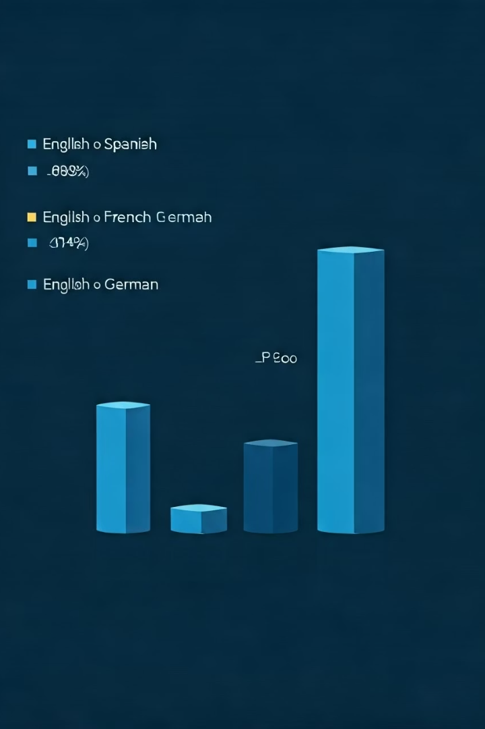
Classification Performance
Language Pair
Accuracy
F1-score
Azerbaijani - Arabic
97.32%
0.9722
English - German
91.16%
0.9116
Romanian - Hungarian
94.86%
0.9441
Our classifier (training_classifier.ipynb) predicts each word's probability of being a false loan word within a sentence. For example, given the sentence "The government governed a new abordage policy," our model correctly identifies "abordage" as the false loan word.

Slide 7





Translation-Based Validation
Generate Source
Translate Back
Compare Results
Analyze Drift
Create a German sentence using the potential loan word
Convert the sentence back to English
Use BLEU and METEOR scores to evaluate translation quality
Identify semantic changes that indicate false loan words
This round-trip translation approach helps us identify words that lose their intended meaning when translated between languages, a key indicator of false loan words. The process is implemented in translation.ipynb.

Slide 8








LLM-Based Detection
Input Sentence
Expert Prompt
Process text containing potential false loan words
Query LLaMA 3.2 with linguistic expertise framing
Single Word Output
Analysis
Return only the detected false loan word
Model identifies suspicious terms based on context
Our approach uses Ollama with LLaMA 3.2 to predict false loan words from sentences. The model is prompted to act as a linguistic expert and identify words that seem borrowed but are wrongly used or misinterpreted, outputting only the false loan word if found.

Slide 9








Detection Refinement Strategy
Combined Filtering
Integrate multiple signals for robust detection
Translation Quality
BLEU & METEOR scores below 0.5
Embedding Analysis
German similarity > English similarity
LLM Verification
Confirmation from LLaMA model
We employed a post-classification filtering strategy based on multiple indicators. A word is flagged as a false loan word if the German embedding similarity is higher than the English one, and at least 3 out of 4 conditions are satisfied. This approach achieved a final detection accuracy of 65.79%.

Slide 10
Key Finding & Implementation
Critical Insight
Implementation Files
German similarity dominance in the embedding space strongly correlates with false loan word presence in translated sentences. A higher German embedding similarity indicates that the German word is more semantically aligned, suggesting the English term might be a false loan word.
training_bert.ipynb: Fine-tunes mBERT on labeled pairs
bert_result.ipynb: Stores results across language pairs
training_classifier.ipynb: Trains sentence-level classifier
This finding provides a powerful heuristic for identifying words that have been misappropriated across languages, even when traditional translation metrics might miss them.
translation.ipynb: Generates translation metrics
false_loanword_classifier.ipynb: Combines mBERT + LLM

Slide 11



Usage Guide & Future Work
Setup Environment
Clone repo and install requirements
Train or Download Models
Fine-tune or use pretrained models from Google Drive
Run Analysis Pipeline
Process text through the complete detection system
Future work includes fine-tuning deeper layers of BERT, incorporating XLM-RoBERTa and XLBERT, expanding to more language pairs, and adding contextual paraphrase detection. Our project builds a robust pipeline for multilingual loan word classification using a combination of machine learning and LLM reasoning.

